Slide 1
The Presentation for Final Project
Lanqing Zhao

Slide 2
Motivation of the Project
There are many online discussions about the income and quality of life between the US and the western European countries such the UK and Germany
The tech industry in the US was booming in the past decade, so I am interested in seeing comparison between the US and the western European countries
The mountain states such as Colorado and Utah are the fast-growing region in the country, so I am interested in seeing how tech sectors are in this part of the US

Slide 3
The research question
Is there a difference statistically between the salary of software engineers in US mountain states and west European countries such as the UK and Germany
Is there a difference statistically within Mountain states or within the UK and Germany?

Slide 4
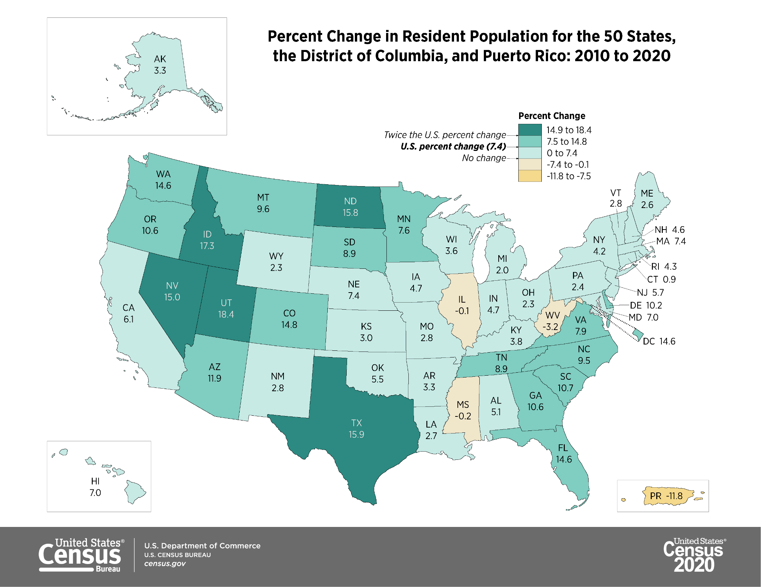
Literature Review
This problem is related to economics, so I take a look at economic data
GDP per capita;(2021 in usd)
US:70,248
UK: 46,510
Germany: 51203
Median household income (in 2021)
US: 70784 usd
UK 34000 gbp
Germany: 59748 euro

Slide 5
My approach
Gather recent data from Glassdoor.com of software engineer job posts within 50 mi of Denver, Salt Lake City, Greater London, and Berlin
Process them to compare the visual and statistical difference between each region, different countries, and within the US or Europe
Conduct one-way ANOVA to see the result

Slide 6
Conclusion
There is a significant difference in terms of Software Engineer position between Denver / SLC and UK and Germany
There is a slightly significant difference between Denver and SLC
The limit of our data is that we only sampled Berlin, and it does not render enough data. Additionally, Berlin is not the most economic developed area in Germany.
We also need more data for other regions of the US and UK, as Denver and SLC are also not the areas with the most tech positions.

